Slide 1




Electronic Correspondence System
ECS ®
Copyright © 2015 Estarta Solutions. All rights reserved.

Slide 2

Agenda
Estarta ECS
  Business Value
  Transaction Life Cycle
  Main Features
Technical Design
  Logical design and scope of work
  Hardware & Software Quantities
Demo

Slide 3
ECS Overview
Electronic Correspondence System (ECS) is an enterprise mail and correspondence circulation and tracking solution that aims at facilitating & streamlining mail registration, processing and filing operations in large organizations.
E-Correspondence provides:
  Central Transactions Repository
  Transaction Imaging and Scanning
  Transactions Routing Across Departments and Work Centers
  Transactions Movement Tracking
  Barcode Reading / Printing
  Transactions Classification and Filing

Slide 4
Business Value
E-Correspondence
  Improves Productivity
  Increases Efficiency
  Increases Transparency
  Reduces Operational Cost
  Enhances Decision Making Process
Scalability
  Grows with the Business
Security
  Controls Transactions Accessibility
  Access Control at User, Department and Cabinet levels
Notes:
Grows with the business: E-Correspondence allows for multiple deployment configuration/architecture depending on the business need and transactions volume.

Slide 5














Transaction Life Cycle
1
4
_{Inbound Mail}
_{Paper Document}
2
_{Outbound Mail}
_{Electronic Document}
3
6.B
_{Inbound Registration}
_{Outbound Registration}
_{Central Database}
6.A
Mail Circulation Among Departments
_{Central Archive}
5
7
8
_{Classification and File Saving}

Slide 6
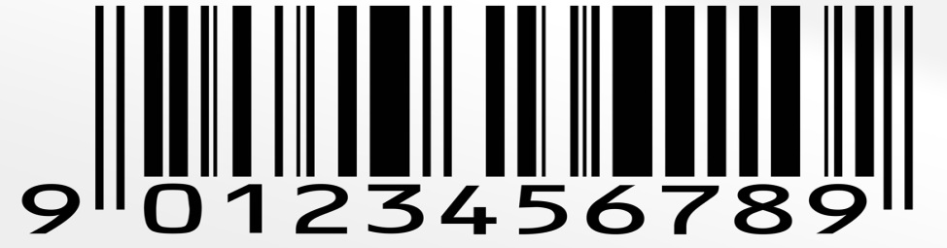



Main Features
Barcode Support
Actions & Transactions Tracing
Powerful Search
Document Imaging
Transactions Copies Handling
Linkage of Transactions
Security fully integrated with Active Directory
Integrate with SharePoint 2010 as back-end DMS

Slide 7
Main Features – Cont’d
Multi-Cabinet
  Supports communication between different cabinets
  Auto Links on Multi-Cabinet communications
Outbound
  Outbound Draft Processing
  Distribution Lists
Assignment
  Email notification on Assignments
  Respect of Organization Hierarchy
  Full Electronic Assignment without paper or manifest

Slide 8
Technical Design
Copyright © 2015 Estarta Solutions. All rights reserved.
8

Slide 9




Architecture
Based on Open Industry Standards
Built on Microsoft® .Net Framework
Leverage Microsoft Office SharePoint Server 2013
Deployed on Microsoft Windows® 2012 Servers and Microsoft Internet Information Services® (IIS)
Microsoft SQL Server® 2012 is used to store all documents, tracking, and routing data.

Slide 10
Logical Design
Users
Database Store
Business Module
Backend
Staff
Reports
Managment
Electronic documents
Employees
Inbound
Outbound
Archiving Module
Assignment Module
Infromation Center Module
Search Module
Logging and Auditing Module
System Administration Module

Slide 11
Deployment View

Slide 12

Questions and Answers

Slide 13

Thank You!
For more details, please contact BizDev@EstartaSolutions.com

